Slide 1
Fine-tuning and Compression of LLMs
Christina Joslin
04/03/2026

Slide 2
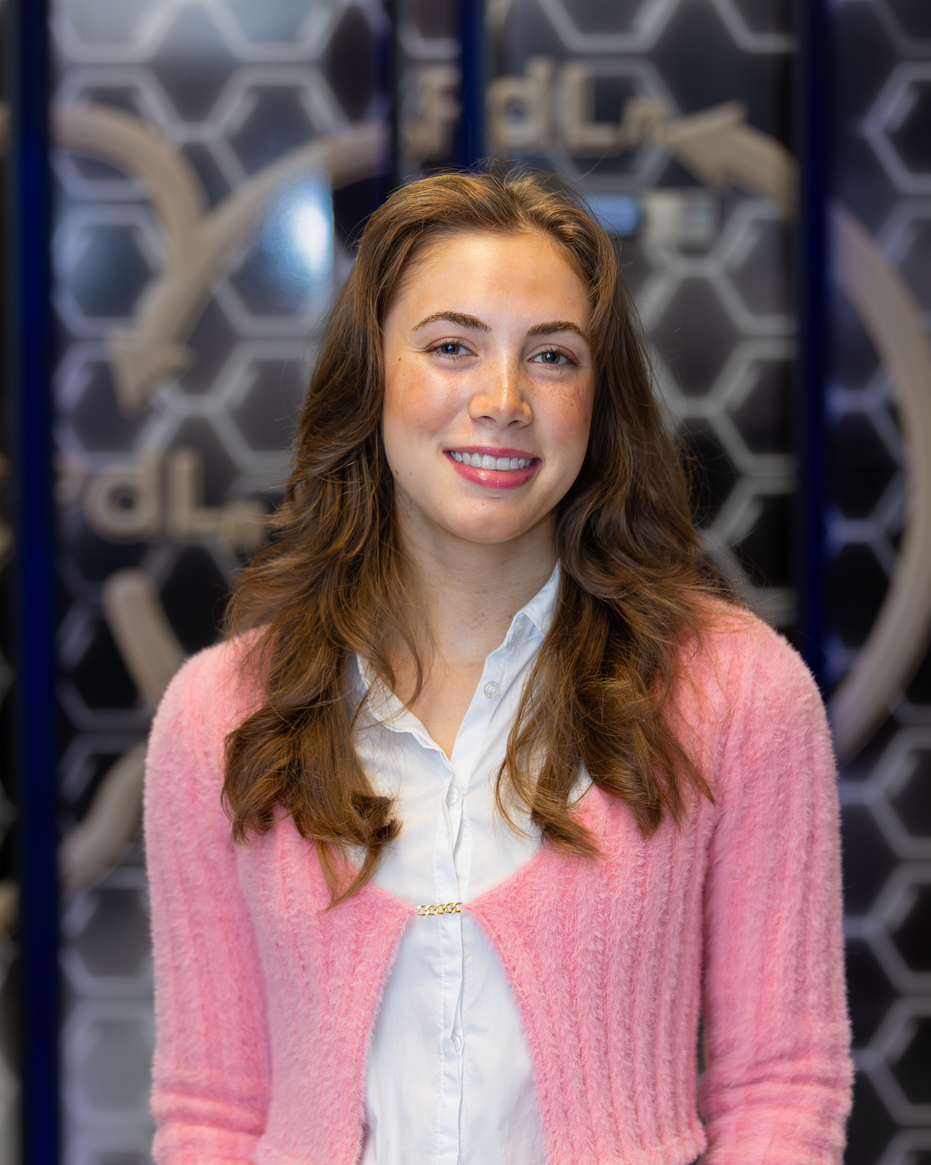
About the Instructor
Christina Joslin
Undergraduate Senior in Data Science and Applied Statistics
Research Assistant at RCAC (since May 2025) - working on Generative AI use cases and applied machine learning in high-performance computing
Previous Experience – Teaching Assistant in The Data Mine Corporate Partners Program; Research Assistant in the Sustainable Transportation Systems Research Group

Slide 3
Agenda
Opening & Motivation
LLM Fine-Tuning Fundamentals
Parameter-Efficient Fine-Tuning (PEFT)
Model Compression & Quantization
Fine-Tuning Workflow (Demo)
Wrap-Up & Q&A

Slide 4
Opening & Motivation

Slide 5




Why Not Train from Scratch (aka Pre-Training)?
Training LLMs from Scratch is Computationally Expensive!
YOUR Task
(Specialized Objective)
Today’s foundation models such as enterprise OpenAI, Anthropic, or Google Gemini, as well as popular open-source LLMs like LLaMA and Microsoft Mistral variants, require:
Billions of tokens of training data
Weeks to months of training time
Large-scale GPU clusters
Millions of dollars in compute cost
Pre-training Objective
(Broad, Multi-Domain Loss)
Strong Generalization &
Weak Specialization
Notes:
Due to the vast amount of information they are trained on (only a portion of which is relevant to your task), may not perform as well as-is even with Retrieval Augmented Generation (RAG) (more on this on slide 7).

Slide 6
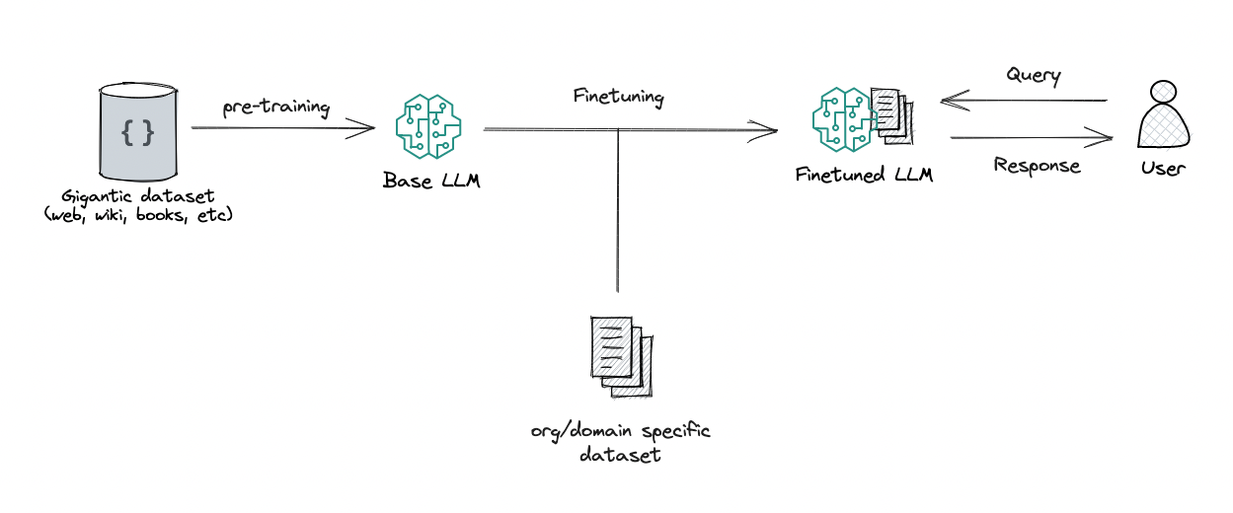
How Fine-Tuning Addresses this Gap
Fine-tuning re-optimizes a pre-trained model on task-specific data
YOUR Task
(Specialized Objective)
https://towardsdatascience.com/rag-vs-finetuning-which-is-the-best-tool-to-boost-your-llm-application-94654b1eaba7
Fine-tuning Objective
(Narrower, Single Domain Loss)

Slide 7
Fine-Tuning vs. Retrieval Augmented Generation
Fine-Tuning | Retrieval Augmented Generation
Changes the pretrained model by retraining on task- or domain-specific data | Does not change the pretrained model Retrieves relevant external information and injects it into the prompt at inference time
Best when: You need a strict or consistent input/output format (e.g., custom chatbot templates, structured responses) Model behavior must be highly specialized You have sufficient labeled training examples You have enough compute to train | Best when: The pretrained model already performs reasonably well Input format can remain flexible You have limited labeled data Compute or training budget is constrained Knowledge needs to be up-to-date or external

Slide 8
LLM Fine-Tuning Fundamentals

Slide 9


Fine-Tuning Approaches
How the model is trained
Supervised Fine-Tuning (SFT)
Trains a pretrained LLM on labeled input–output pairs
Primary starting point for task adaptation
Directly teaches desired responses
Reinforcement Learning from Human Feedback (RLHF)
Uses preference comparisons between model outputs
(e.g., thumbs up/down, rankings, star ratings)
Optimizes behavior using a reward signal
Commonly applied for alignment and safety after SFT
Notes:
In this workshop, we will only focus on Supervised Fine-Tuning (SFT).

Slide 10
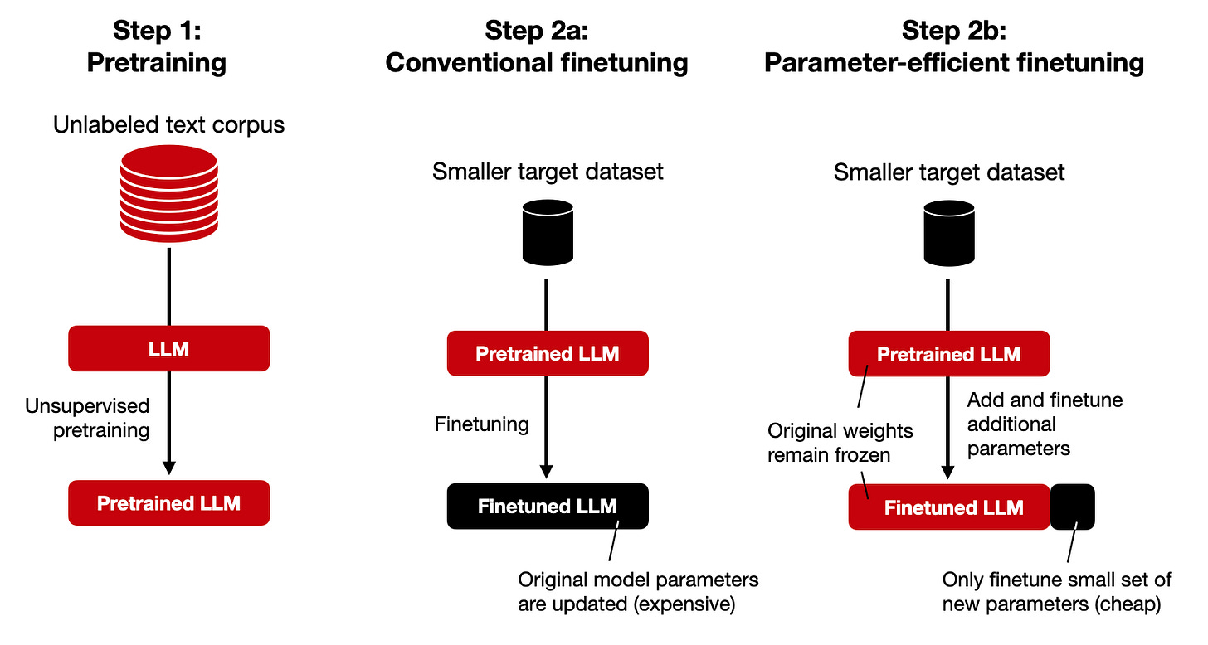
Types of Supervised Fine-Tuning (SFT)
How many parameters are updated
Full Fine-Tuning
Parameter-Efficient Fine-Tuning
https://magazine.sebastianraschka.com/p/finetuning-llms-with-adapters

Slide 11
Parameter-Efficient Fine-Tuning

Slide 12
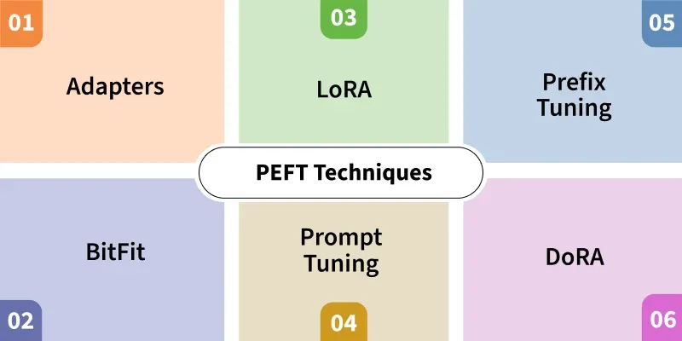
Types of Parameter Efficient Fine-Tuning (PEFT)
Today's demo will focus on LoRA (Low-Rank Adaptation)
https://www.geeksforgeeks.org/artificial-intelligence/what-is-parameter-efficient-fine-tuning-peft/
Notes:
Within the types of PEFT there are two different 'categories' of update types (we will go into detail on each of these in the next slide):
(1) Weight-based methods: update the model’s behavior by modifying a small subset of the model’s parameters, changing how the model processes all inputs (e.g., Adapters, LoRA, DoRA, BitFit).
(2) Prompt-based methods keep all model parameters frozen and instead learn additional vectors that modify what the model sees as context, steering attention without changing the model itself (e.g., Prompt Tuning, Prefix Tuning).

Slide 13
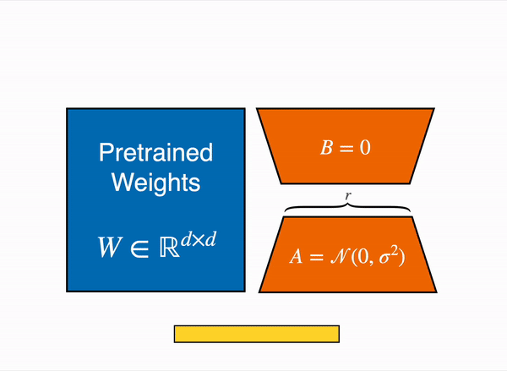

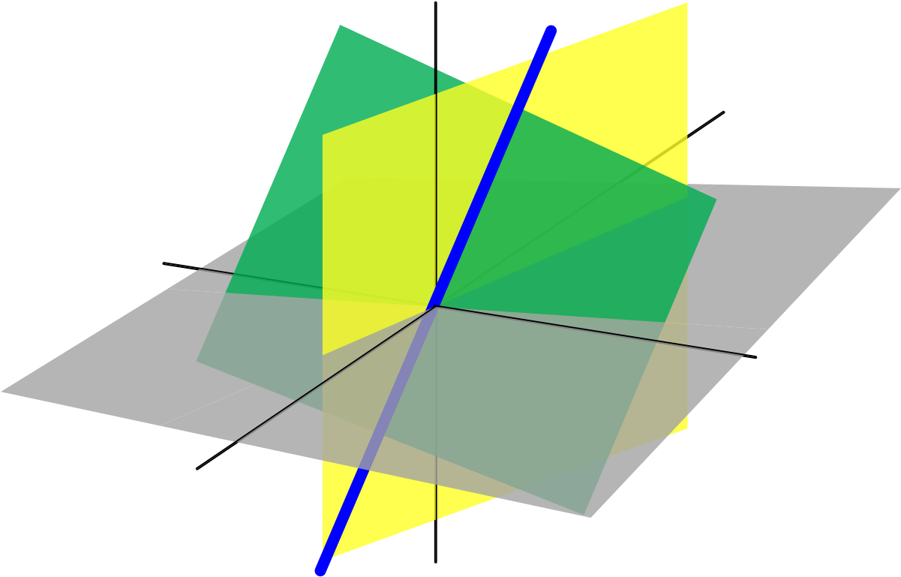
Low-Rank Adaptation (LoRA)
PEFT Weight-Based Method
Definition: LoRA learns a low-rank weight update ΔW (orange blocks) that acts as an additive correction term to the pretrained weights W (blue block).
W_{effective} = W + ΔW
Instead of learning ΔW directly, it is parameterized as the product of two low-rank matrices: ΔW = BA:
Forward Pass: y = x(W+BA) = xW + xBA = h
Learnable Parameters: r(m + n) = r(d + d) = r(2d)
Restricts the weight correction to a small number (r) of learned adaptation directions using a low-rank factorization.
https://huggingface.co/blog/samuellimabraz/peft-methods
https://huggingface.co/blog/samuellimabraz/peft-methods
Notes:
A full weight update allows changes across all possible directions in the parameter space, which is expensive and often unnecessary. LoRA applies a low-rank constraint by expressing the weight update ΔW as the product of two smaller matrices. This limits the update to r≪d independent adaptation directions, capturing the most important task-specific changes while significantly reducing the number of trainable parameters.
Note: LoRA updates (ΔW) are applied only to selected weight matrices, most commonly attention projection layers (Query, Key, Value, and sometimes Output), which are specified via hyperparameters.

Slide 14

Low-Rank Adaptation (LoRA)
PEFT Weight-Based Method
Hyperparameter | Purpose | Recommended Values
Rank (r) | Controls the number of adaptation directions (capacity of the low-rank update); higher values increase expressiveness but also memory and compute cost | 8, 16, 32, 64, 128 (start with 16 or 32)
Scaling (α) | Controls the strength of the LoRA update and stabilizes training. The effective update is scaled as: | α=r or α=2r (common heuristic)
Target Modules | Specifies which weight matrices LoRA adapters are applied to, enabling targeted adaptation: Attention: q_proj, k_proj, v_proj, o_proj MLP (feed-forward): gate_proj, up_proj, down_proj | Target all major linear layers: q_proj, k_proj, v_proj, o_proj, gate_proj, up_proj, down_proj.
Dropout | Regularization that randomly drops entries of each LoRA activation tensor during training to reduce overfitting (not as useful because base model dominates so diminished risk of overfitting). | 0.0 (default) – 0.1
Weight Decay | Regularization term that penalizes large weights to prevent overfitting | 0.01 (recommended) - 0.1
https://unsloth.ai/docs/get-started/fine-tuning-llms-guide/lora-hyperparameters-guide
https://huggingface.co/blog/samuellimabraz/peft-methods

Slide 15
Low-Rank Adaptation (LoRA)
Hyperparameters: Projection Layer Definitions
Projection Layer | Role
Query (q_proj) | Encodes what a token is looking for in the context
Key (k_proj) | .Encodes what information a token offers to be matched
Value (v_proj) | Carries the actual information that is aggregated by attention
Output (o_proj) | Combines attended values into the layer output
Gate (gate_proj) | Controls information flow within the Multi-Layer Perceptron (MLP)
Up (up_proj) | Expands representations to increase expressive capacity
Down (down_proj) | Compresses representations back to model dimension
https://unsloth.ai/docs/get-started/fine-tuning-llms-guide/lora-hyperparameters-guide
https://huggingface.co/blog/samuellimabraz/peft-methods

Slide 16
Other Weight-Based Methods
How the model is trained
Adapters
Insert small trainable fully connected (bottleneck) networks after specific transformer sublayers, while keeping the original model weights frozen.
DoRA (Weight-Decomposed LoRA)
Extends LoRA by decomposing the weight update into direction and magnitude components: direction is handled via standard LoRA, while magnitude is controlled by a separate learnable parameter.
BitFit
Updates only the bias terms in the model.
https://www.geeksforgeeks.org/artificial-intelligence/what-is-parameter-efficient-fine-tuning-peft/

Slide 17
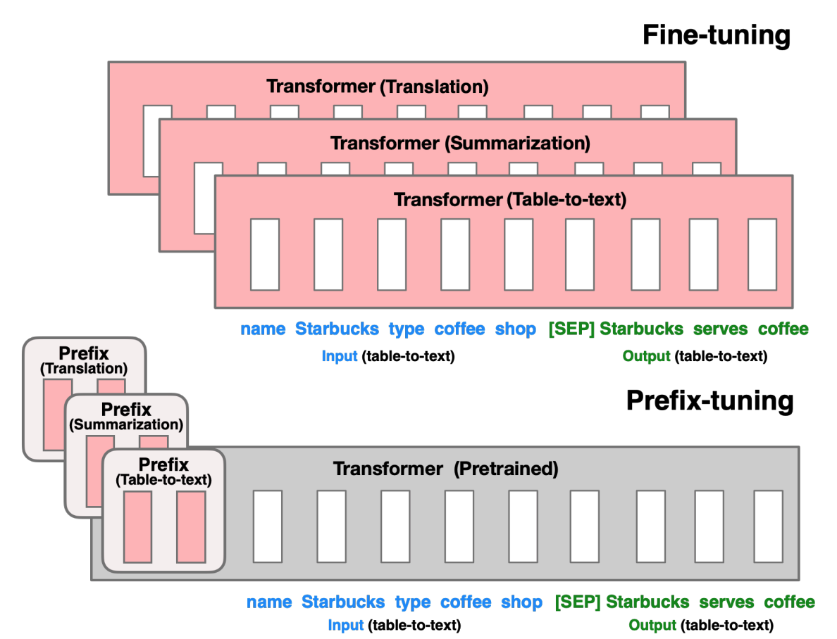
Prompt-Based Methods
How the model is trained
Prefix Tuning
Learns a small set of task-specific prefix vectors that are injected into the attention mechanism at every transformer layer.
During training, prefixes may be generated via a small fully connected network for stability, but only the learned prefix parameters are retained at inference, making prefix tuning highly parameter- and storage-efficient.
https://arxiv.org/abs/2101.00190
https://huggingface.co/blog/samuellimabraz/peft-methods

Slide 18
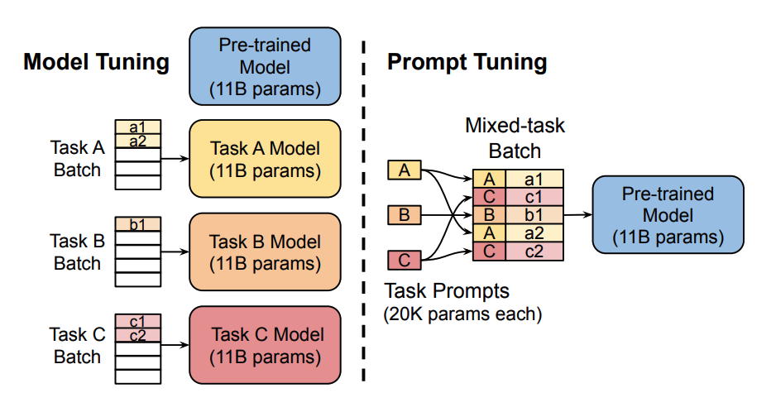
Prompt-Based Methods
How the model is trained
Prompt Tuning
Adds a small set of trainable “soft prompt” vectors to the model’s input embeddings while keeping all model weights frozen
Soft prompts are continuous, non-interpretable vectors (initialized randomly or from embeddings) and only these prompts are updated during training, with prompt length as a tunable hyperparameter
Most effective for very large models (≈10B+ parameters), where performance can approach full fine-tuning
Introduces minor computational overhead due to additional prompt tokens in the input sequence
https://arxiv.org/abs/2104.08691
https://www.geeksforgeeks.org/artificial-intelligence/what-is-parameter-efficient-fine-tuning-peft/

Slide 19
Model Compression & Quantization

Slide 20


Two Types of Compression in LLM Workflows
Compression During Training vs. During Deployment
During Training
(e.g., QLoRA)
Compression techniques are applied to reduce GPU memory usage during training
Enables fine-tuning large models on limited hardware
Prevents out-of-memory errors during training
During Deployment
(e.g., GGUF for Ollama)
Compression techniques are applied to reduce GPU memory usage during serving
Enables running fine-tuned large models on limited hardware
Prevents out-of-memory errors during inference
Goal: Make fine-tuning LLMs feasible.
Goal: Make trained models runnable and easy to deploy

Slide 21
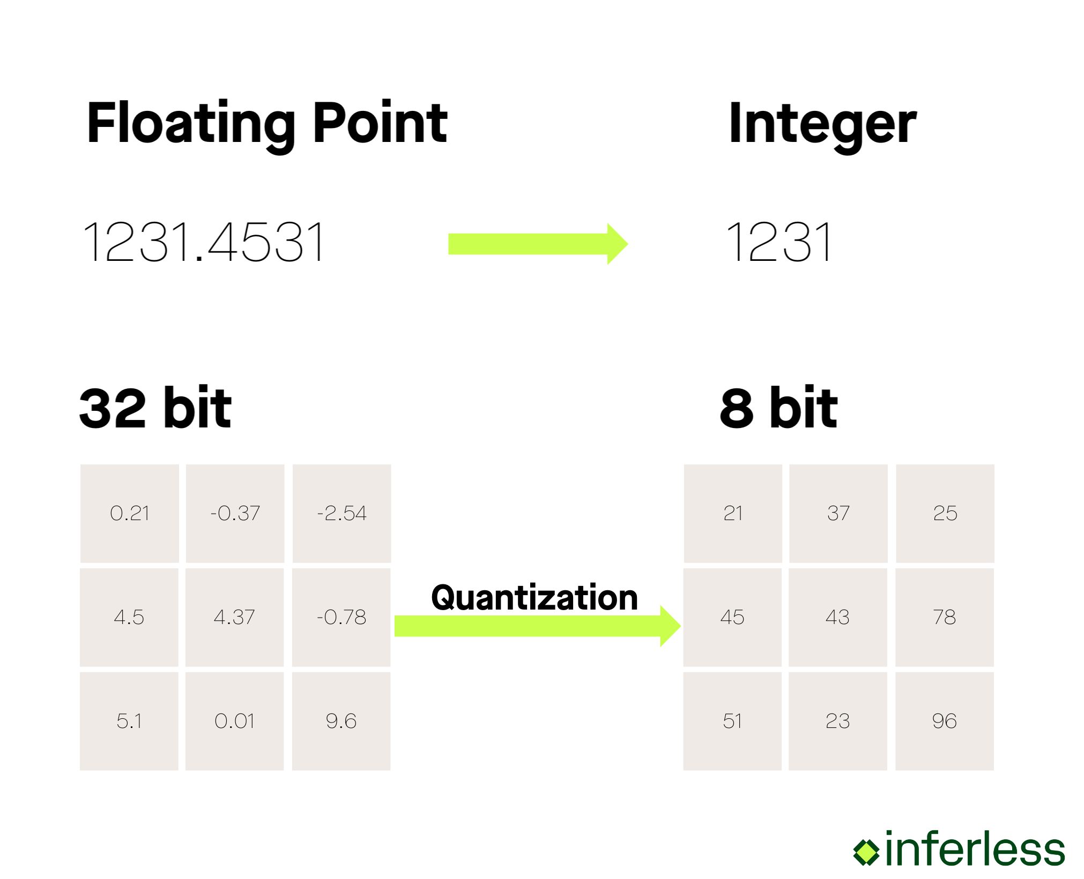

Types of Compression: Quantization
Intro to Quantization
Represents numerical model weights using fewer bits
Instead of FP16 (16-bit floats) / FP32 (32-bit floats):
  INT8 (8-bit)
  INT4 (4-bit)
Reduces:
  Model size
  GPU/CPU memory usage
  Inference latency
Tradeoff between Precision and Efficiency
https://www.inferless.com/learn/quantization-techniques-demystified-boosting-efficiency-in-large-language-models-llms
Notes:
Instead of changing the model architecture we are changing how precisely numbers are stored as for many tasks not all decimals are needed for determining accuracy.

Slide 22
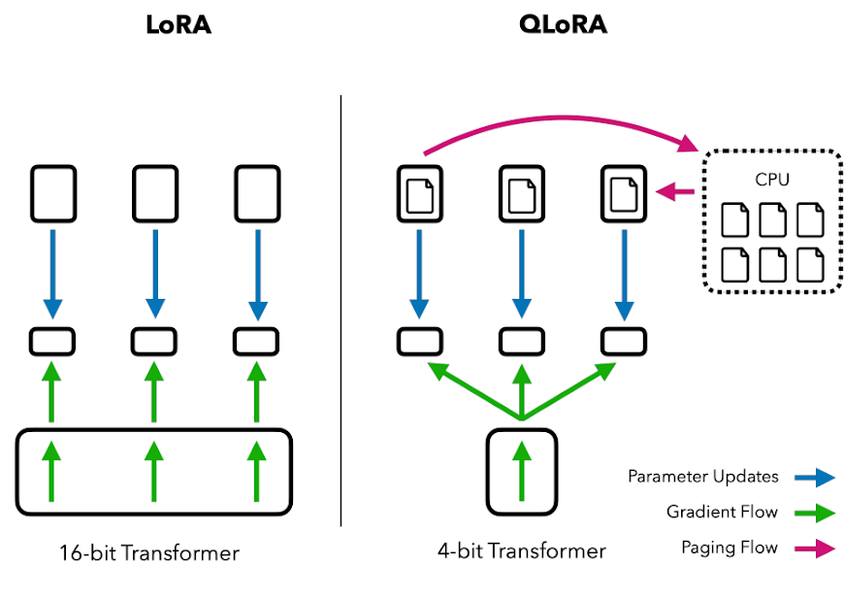
QLoRA
Compression During Training
4-bit / 8-bit Normal Float (NF4 / NF8): Quantizes weights using values matched to the typical (roughly Gaussian) weight distribution, preserving quality better than naive rounding.
Double Quantization: Further reduces memory by also quantizing the scaling factors used in weight quantization.
Paged Optimizers: Manage GPU memory spikes during training by paging optimizer states between GPU and CPU memory, preventing out-of-memory errors.
https://www.mercity.ai/blog-post/guide-to-fine-tuning-llms-with-lora-and-qlora
Notes:
Scaling factors are used to map the quantized values to the original real values.

Slide 23
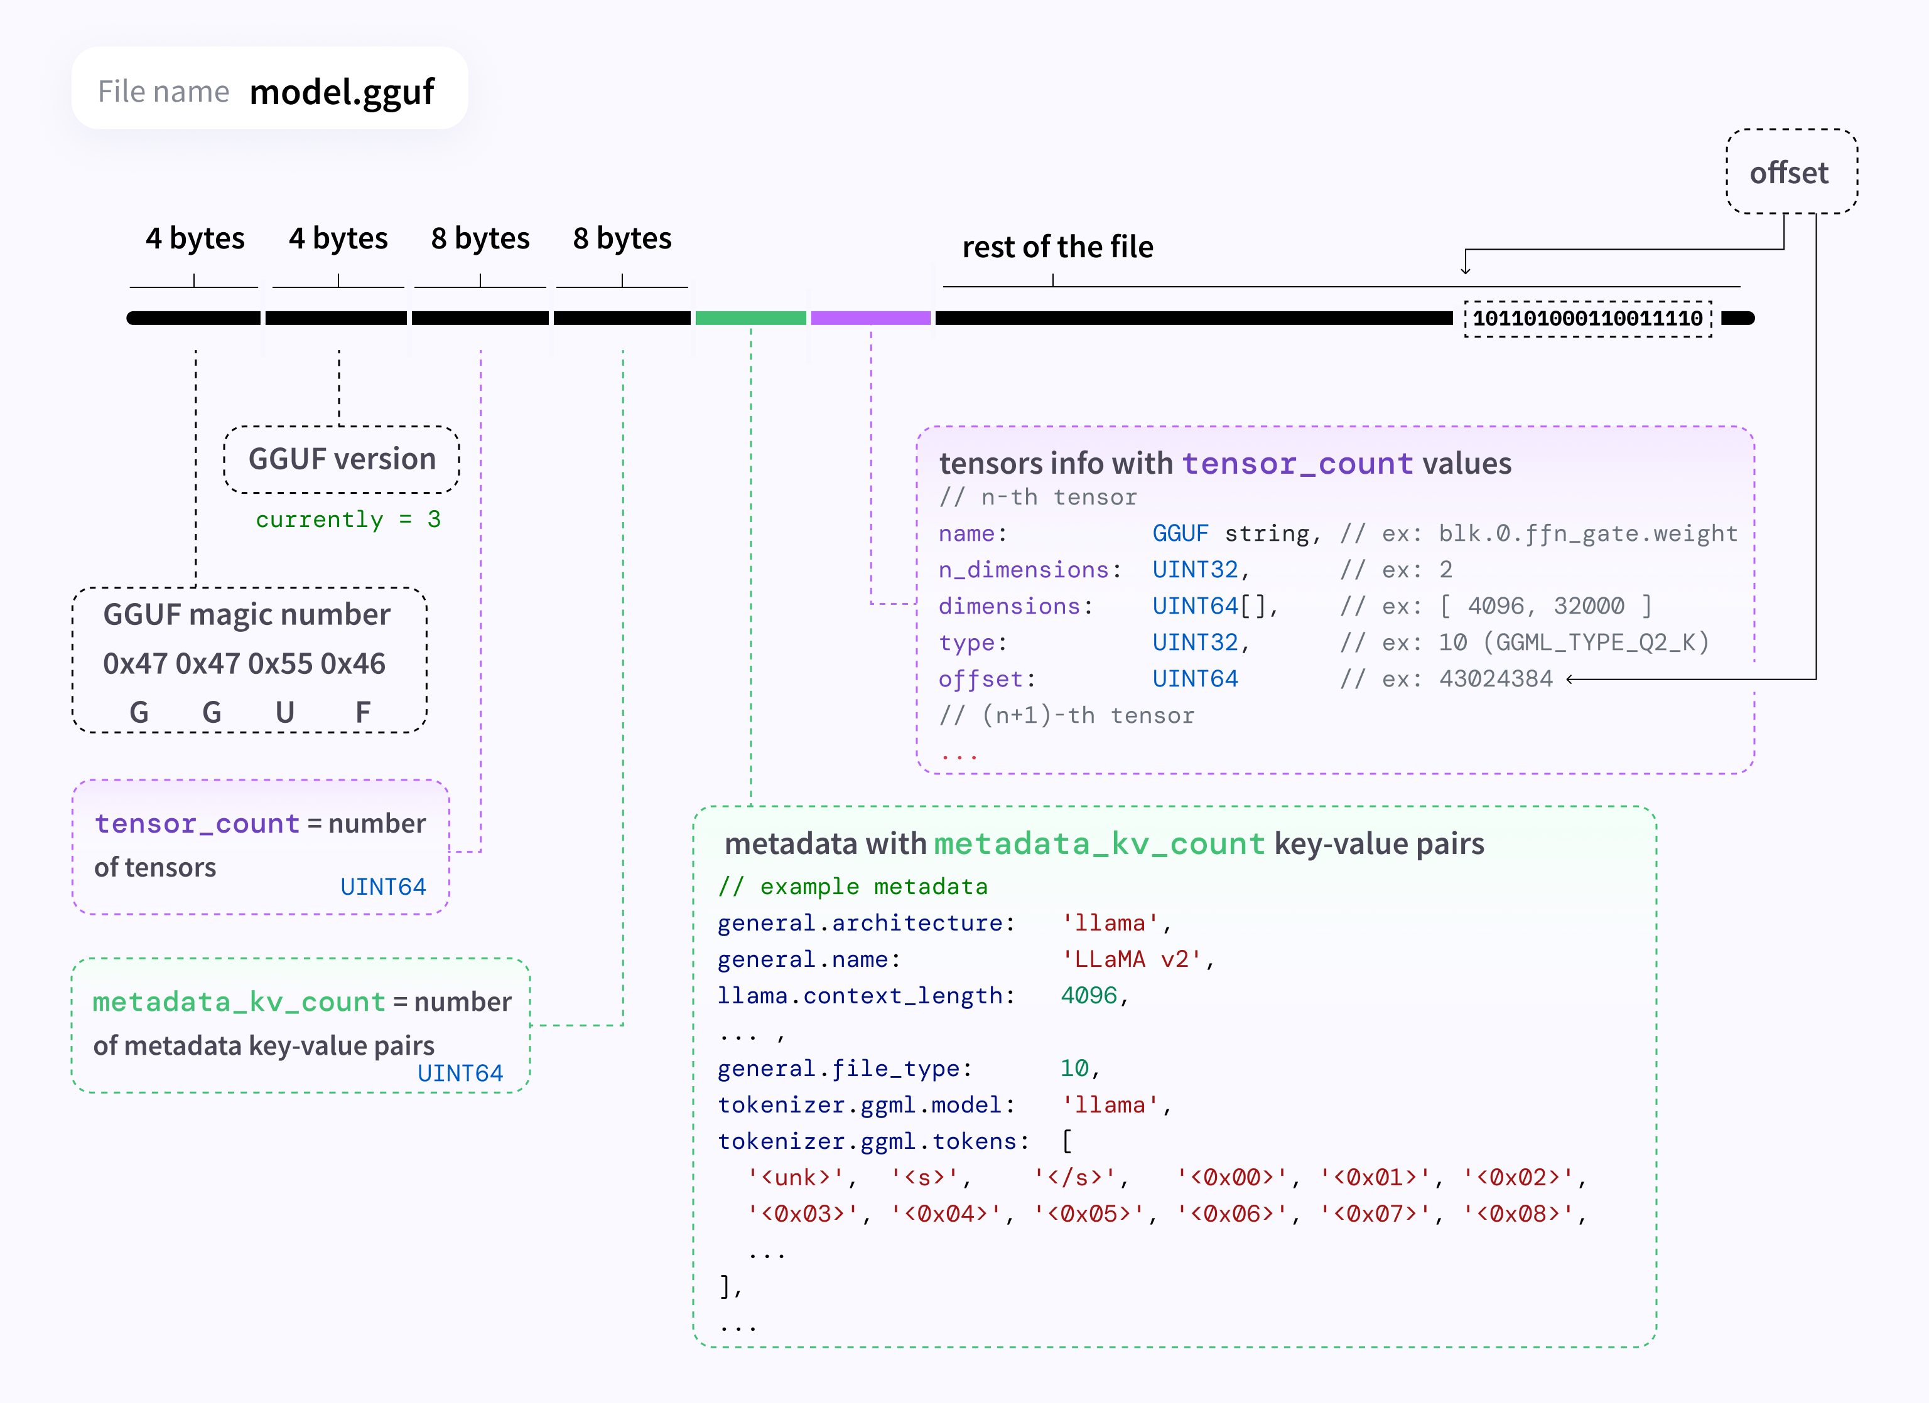
GPT-Generated Unified Format (GGUF)
Compression During Deployment
GGUF is a quantized model file format designed for efficient CPU/GPU inference
Stores model weights in compressed precision (e.g., INT8, INT4) along with tokenizer and metadata
Optimized for low-memory, local inference, especially on consumer hardware
Commonly used by inference engines such as Ollama
https://huggingface.co/docs/hub/en/gguf
Notes:
GGUF compresses models so they can be stored, shared, and run efficiently at inference time.

Slide 24
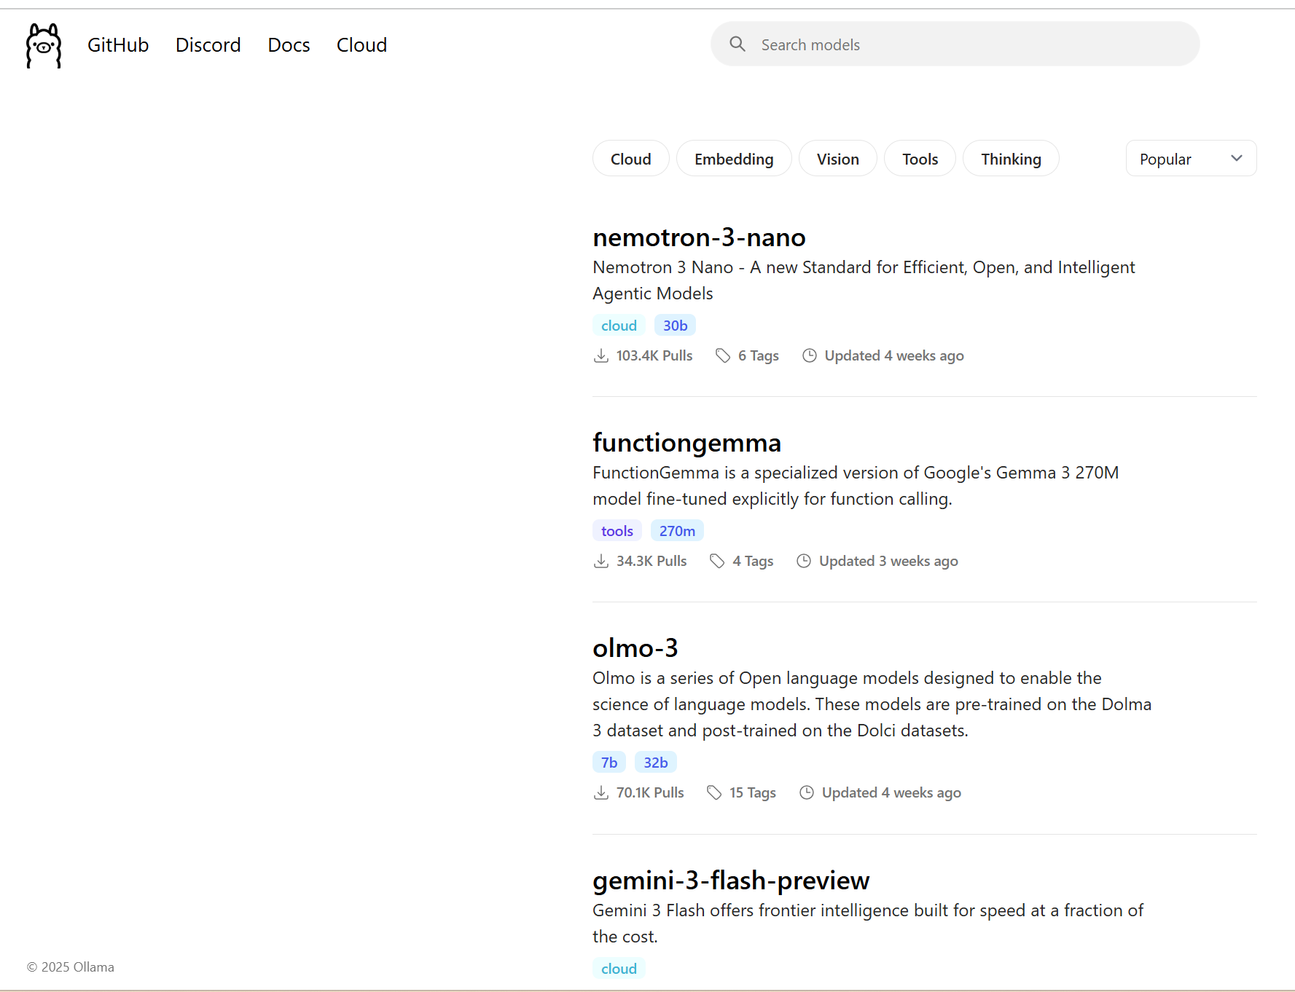
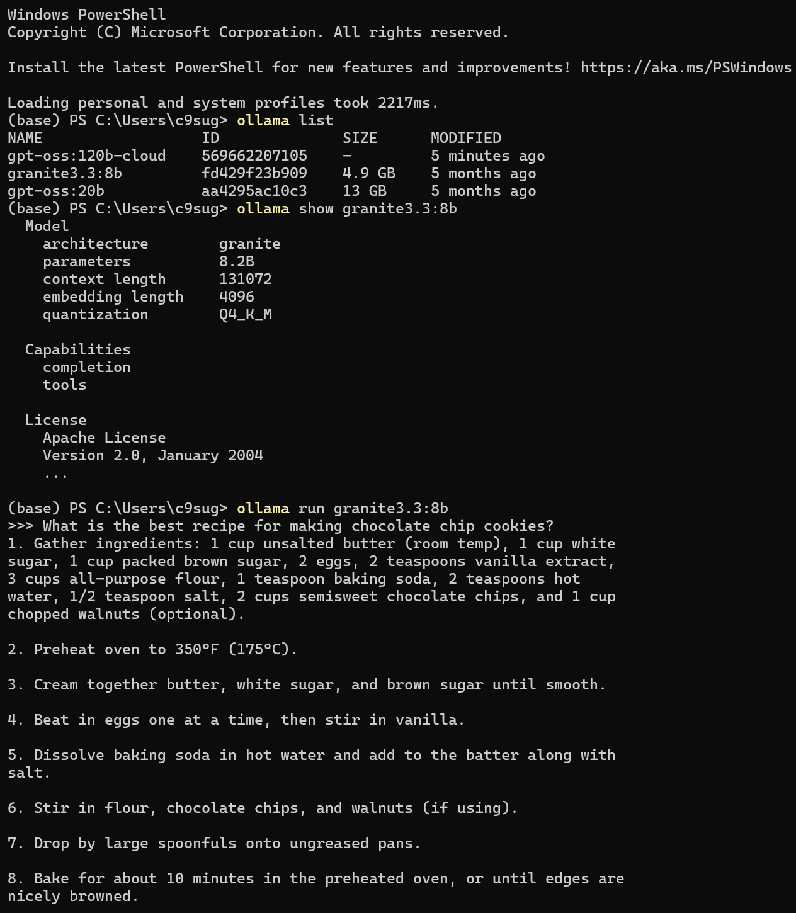
Ollama Hub Ollama (Local)
https://ollama.com/
https://docs.ollama.com/cli
Notes:
Ollama Local is the runtime that executes GGUF models directly on your machine, handling model loading, memory, and inference without requiring cloud services. In addition to command line, Ollama recently launched a GUI for interacting with both locally hosted as well as cloud-based LLMs (e.g., gpt-oss:120b).
Ollama Hub is an optional online registry used to share and download models; it is not required to run models locally with Ollama.

Slide 25
Important Ollama Commands
Command | Description
ollama run <model> | Pull specified model and starts an interactive session
ollama pull <model> | Downloads a model from the Ollama Hub library without running it
ollama list | Lists all models that have been downloaded to your local system
ollama ps | Lists models currently running in the background
ollama stop <model> | Stops a specified running model
ollama stop | Stops all currently running models.
ollama show <model> | Display detailed information about the model such as its parameters, license, and Modelfile details
ollama create <new_model> -f <Modelfile> | Create a custom model using a specific Modelfile
ollama push <model> | Push a model to a registry (e.g., Ollama Hub)

Slide 26
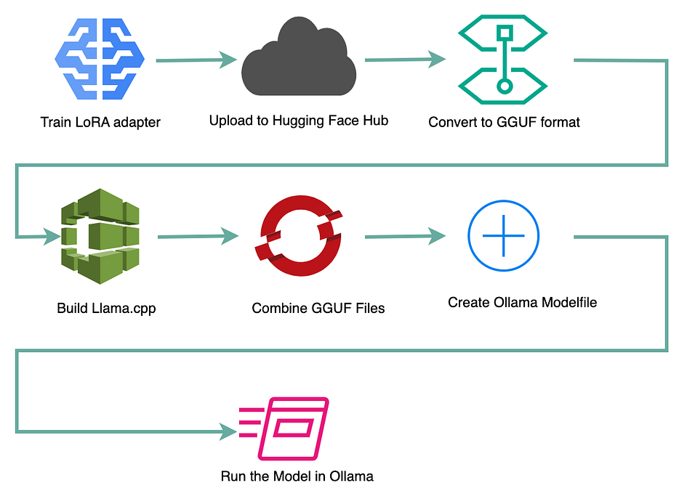

How GGUF Works with Ollama
GGUF + Modelfile = Production-Ready LLM
Fine-tuned or pretrained models are converted to GGUF after training
Quantization is applied at export time (not during training)
Ollama loads the GGUF file + Modelfile and runs inference directly from the quantized weights
Enables running large models locally or on shared compute resources without requiring GPUs or large VRAM
How to Create Modelfile
https://ollama.readthedocs.io/en/modelfile/
Notes:
To run a model locally with Ollama, you need a GGUF file for the weights and a Modelfile that tells Ollama how to use it.

Slide 27
Fine-Tuning Workflow
Unsloth's Jupyter Notebook Demo
Mistral v0.3 (7B)
Notes:
We will be walking through one of the demo notebooks for fine-tuning Mistral v0.3 (7B) using LoRA from Unsloth.
Mistral v0.3 (7B): https://colab.research.google.com/github/unslothai/notebooks/blob/main/nb/Mistral_v0.3_(7B)-GRPO.ipynb
Link to all Demo Notebooks (Created and published by Unsloth): https://unsloth.ai/docs/get-started/unsloth-notebooks

Slide 28
Wrap-Up & Q&A

Slide 29
Typical Workflow for Fine-Tuning LLMs
Stages of Model Fine-Tuning
Choose a Base Model (Size, Cost)
Prepare and Format Data
Select Method (LoRA, QLoRA, FitBit,…)
Model Training and Testing
Convert to GGUF File + Modelfile
Run Inference with Ollama

Slide 30




Additional Resources
Learning more about Fine-Tuning LLM Methods
Unsloth Fine-tuning LLMs guide
https://unsloth.ai/docs/get-started/fine-tuning-llms-guide
HuggingFace PEFT Methods guide
https://huggingface.co/blog/samuellimabraz/peft-methods
Ollama Documentation
https://docs.ollama.com/
Unsloth Tutorial Notebooks (Google Colab)
https://github.com/unslothai/notebooks?tab=readme-ov-file

Slide 31

Thank You
Questions?
Email: cjoslin@purdue.edu

