Slide 1


Intro to PyTorch and Tensorflow
Christina Joslin
10/10/2025

Slide 2

About the Instructor
Christina Joslin
Undergraduate Senior in Data Science and Applied Statistics
Research Assistant at RCAC (since May 2025) - working on Generative AI use cases and applied machine learning in high-performance computing
Previous Experience – Teaching Assistant in The Data Mine Corporate Partners Program; Research Assistant in the Sustainable Transportation Systems Research Group

Slide 3





Agenda
Core architectures & programming styles
Tensors (creation, shapes, devices)
Build & train a simple Neural Network
Automatic differentiation
Comparison & Wrap-up

Slide 4
Core Architectures & Programming Styles

Slide 5
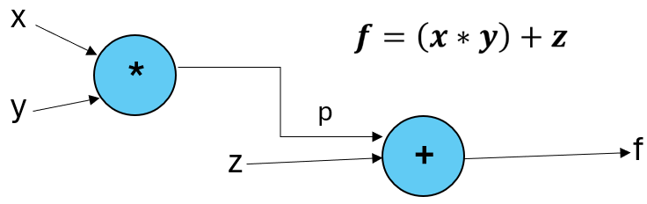
What is a Computational Graph?
A computational graph is a representation of mathematical expressions as a directed acyclic graph (DAG) widely used in deep learning to structure computations into a functional description where:
Nodes
  Represent operations (e.g., addition, multiplication)
  Each node applies a function to its inputs and produces an output
Edges
  Represent variables/tensors (e.g., scalars, vectors, matrices)
  Carry data between operations (e.g., arrows pointing from one operation's output to the next operation's input)
Notes:
Think of your model architecture as a set of mathematical operations, which can be transformed into a computational graph.
Note* Some representations will make nodes the variables and operations the edges but in Tensorflow, PyTorch, and other deep learning libraries it is more common to define nodes and edges as in this slide.

Slide 6
Type of Computational Graphs
Feature | Static Computational Graph | Dynamic Computational Graph
Definition | Graph is predefined before execution. Cannot be modified once built | Graph is built at runtime, created as operations are executed.
Execution Phases | Two phases: (1) Build the graph (architecture), (2) Executive it (train/predict) | Single phase: graph is implicitly defined while running the forward computation
Performance | Uses offline optimization & scheduling (generally faster especially for larger datasets) | Slightly slower unless combined with Just-in-time compilation
Flexibility | Rigid: difficult to handle dynamic input sizes or structures | Flexible: easily supports loops, conditionals, and varying input sizes
Debugging | Harder to debug; need to inspect the graph separately (does NOT tell you which line of code caused the error just that there's a mismatch) e.g., "InvalidArgumentError in node conv2d_3/MatMul" | Easier to debug; feels like regular Python code (tells you which line of code failed)
Framework Examples | Tensorflow (before v2.0) | PyTorch, Tensorflow (v2.x)
https://www.geeksforgeeks.org/deep-learning/dynamic-vs-static-computational-graphs-pytorch-and-tensorflow/
Notes:
Flexibility example (Static Computational Graphs):
In a Convolutional Neural Network (CNN) with a static computational graph, if the model is trained on fixed-size images (e.g., 32×32), it cannot easily adapt to images of different sizes (e.g., 200×200). Handling different input dimensions requires additional preprocessing code, which limits flexibility.
Debugging example (Static Computational Graphs):
Since the user cannot directly observe how information flows inside a static graph, debugging is more challenging. If a malformed graph is created, the error often won’t appear until TensorFlow attempts to run forward or backward propagation, making it harder to trace the bug.
Note on Dynamic Graphs:
Although dynamic computational graphs offer significant flexibility and easier debugging, the trade-off is limited room for optimization. A new graph must be created for each training instance or batch, which can make them less efficient than static graphs.

Slide 7
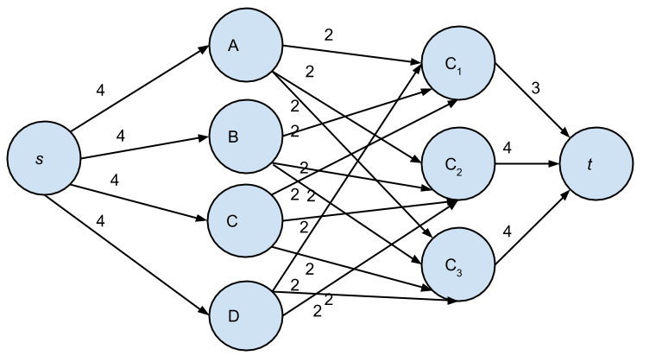
Type of Computational Graphs Contin.
Static Graph
Dynamic Graph
Graph (Pass 1)
Graph (Pass 2)
Build first, run later
Forward and backward passes run on the fixed graph and optimizer updates parameters within prebuilt structure.
.
.
.
Build as you go
Every forward pass dynamically builds a new graph based on the actual operations used.

Slide 8




Tensorflow
Developed by Google, released in 2015
Uses static graphs in Tensorflow ≤ 1.x but Tensorflow ≥ 2.x introduces Eager Execution (dynamic graphs)
Best for production, deployment, and scalability (mobile, edge, cloud)
(e.g., Tensorflow Light, Tensorflow Serving, Tensorflow.js)
Steeper learning curve than PyTorch due to difficulty of debugging (does not tell you what line(s) of code caused your error)
https://intellipaat.com/blog/pytorch-vs-tensorflow-difference/

Slide 9





PyTorch
Developed by Facebook's AI Research (FAIR), released in 2016
Uses dynamic graphs (define-by-run)
Best for research and prototyping because debugging is straightforward (tells you exactly which line(s) are causing an error)
Growing production support (e.g., TorchScript, PyTorch Lightning, TorchServe)
Historically less optimized for deployment than Tensorflow due to focus on ease of experimentation
https://intellipaat.com/blog/pytorch-vs-tensorflow-difference/

Slide 10
Tensors
(creation, shapes, devices)

Slide 11
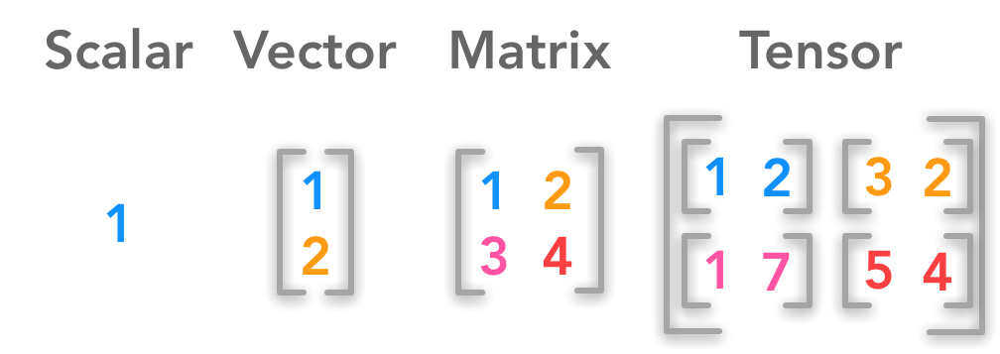


What are Tensors?
Definition: A higher-dimension generalization of vectors and matrices that flows through computational graphs in the form of:
Data (inputs, labels)
Intermediate activations
Model parameters (weights and biases)
Benefits
Optimized Operations: Tensor operations are vectorized and parallelized, avoiding slow Python loops
Device Aware: Can live on CPU, GPU, or TPU, enabling faster training and inference
https://osheenjain.medium.com/what-are-tensors-in-machine-learning-834ae737fc1d
Notes:
Intuition: Think of tensors as multidimensional "containers" of numbers
Tensors are the fundamental data structure of ML used to store/manipulate data

Slide 12
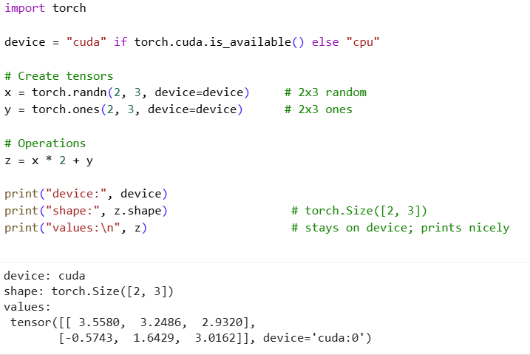

PyTorch Tensors
torch.Tensor is fundamental tensor object in PyTorch
Easily moved between CPU and GPU with .to(device)
Creation: torch.zeros(), torch.ones(), torch.randn(), torch.tensor([…])
Shape manipulation & indexing: .reshape(), .permute()
Learn more: PyTorch Documentation
Notes:
.permute(): reorders dimensions of a tensor (e.g., if a tensor has dimensions (0,1,2) and we say tensor.permute(2,0,1) it rearranges the dimensions to now be (2,0,1))

Slide 13
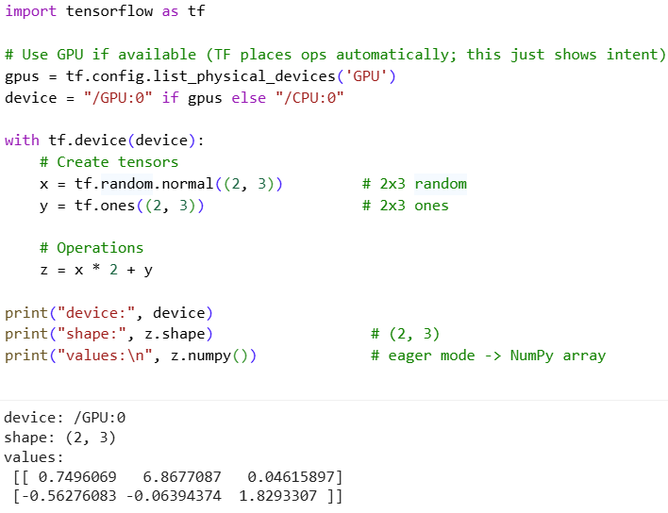

Tensorflow Tensors
tf.Tensor is fundamental tensor object in PyTorch
Device placement handled by Tensorflow (CPU, GPU, TPU); can be specified manually using with tf.device(...)
Creation: tf.zeros(), tf.ones(), tf.random.normal(), tf.constant([…])
Shape manipulation & indexing: .reshape(), tf.transpose()
Eager v. Graph Mode: In Tensorflow 2.x, tensors execute eagerly by default; can also build static graphs with @tf.function
Learn more: Tensorflow Documentation

Slide 14
Automatic Differentiation

Slide 15
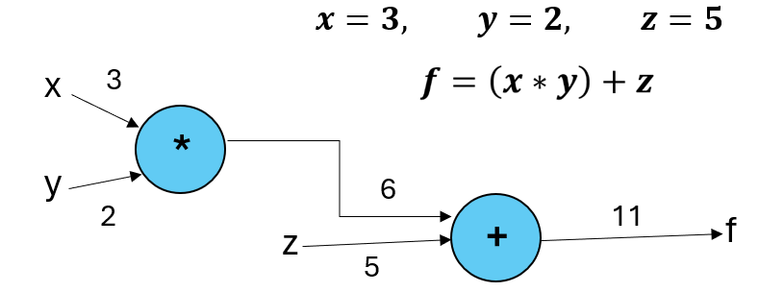
Forward Pass
(Forward Propagation) Compute the output value given the inputs

Slide 16

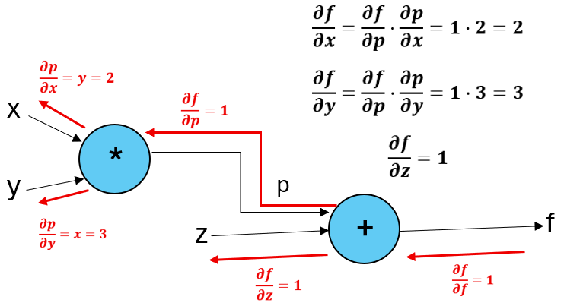
Backward Pass
(Backpropagation) Compute the gradients (partial derivatives) of the final output with respect to each input; used in training deep learning models to adjust parameters
Notes:
The computed gradients indicate how sensitive the output f is to small changes in each input (e.g., if x increases by 1 (keeping y,z fixed), f will increase by about 2). When training, since the model is more sensitive to y than x or z for instance, then the learning algorithm would make a bigger adjustment to y's weight than to z's

Slide 17


What is Automatic Differentiation?
Definition: Automatically performs forward and backward passes, enabling scalable training of deep learning systems (e.g., neural networks)
Low-level: Must call autograd manually
High-level: Frameworks (Keras, PyTorch Lightning, Hugging Face) call it automatically for you

Slide 18



PyTorch's Approach autograd
Automatic gradient tracking: Tensors with requires_grad=True record operations and calling .backward() computes gradients
Gradients stored in .grad: Each parameter's gradient is accumulated in its .grad attribute, ready for the optimizer.
Manual reset needed: Gradients accumulate by default, so you must clear them each training step (optimizer.zero_grad())
Notes:
Note* By optimizer, I am referring to the algorithm you are using to update model parameters using gradients (e.g., Stochastic Gradient Descent (SGD), Adam). After autograd computes gradients, the optimizer applies a rule such as: new_param = param – learning_rate x gradient.

Slide 19




Tensorflow's Approach GradientTape
Explicit recording: Wrap code in a with tf.GradientTape() block to track operations
Gradient computation: After forward pass, call tape.gradient(loss,variables) to calculate gradients
Gradients returned: Values are returned (not stored in variables), and can then be applied with an optimizer
One-time use by default: A tape is consumed after one call unless created with persistent=True

Slide 20
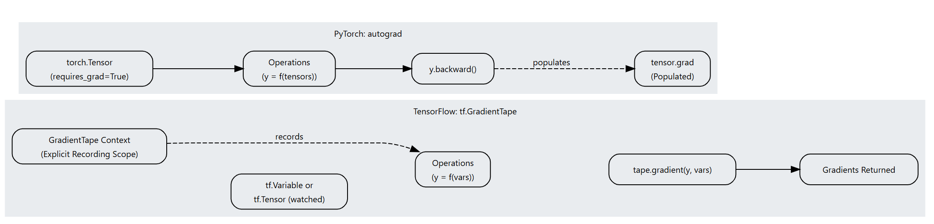
Comparing GradientTape vs. autograd
PyTorch: autograd
TensorFlow: tf.GradientTape
https://apxml.com/courses/pytorch-for-tensorflow-developers/chapter-1-pytorch-tensorflow-core-concepts/autodiff-gradienttape-autograd
Notes:
Key Differences to Note:
Recording style
PyTorch automatically tracks operations on tensors with requires_grad=True.
TensorFlow requires explicitly wrapping code in a tf.GradientTape() block to record operations.
Where gradients are stored
PyTorch accumulates gradients directly in each tensor’s .grad attribute, which persist until manually cleared.
TensorFlow returns gradients as values from tape.gradient(...), rather than storing them in the variables.
Reset vs one-time use
PyTorch requires manual clearing of accumulated gradients each training step with optimizer.zero_grad().
TensorFlow tapes are one-time use by default, consumed after calling tape.gradient(...) unless created with persistent=True.

Slide 21
Build & Train a Simple Neural Network

Slide 22




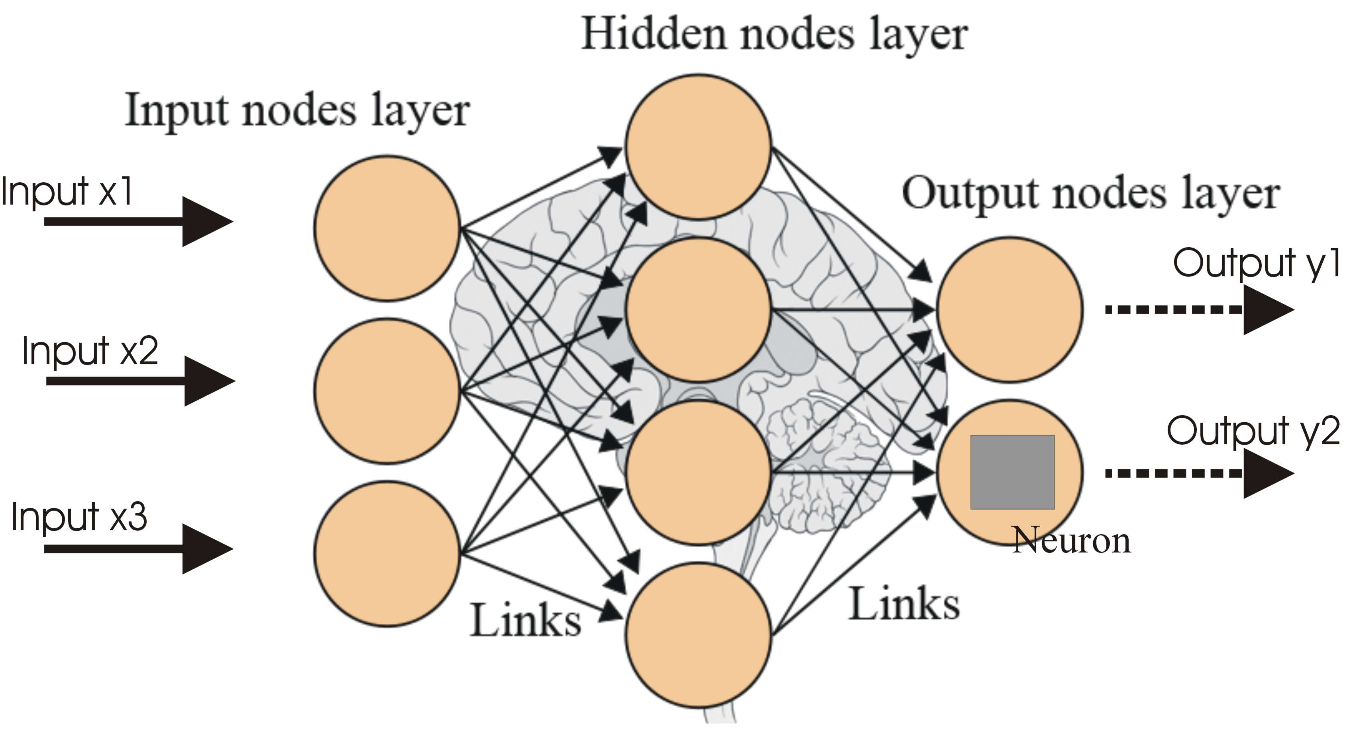
What is a Neural Network?
Neural Network Playground
Inspired by the brain: Built from layers of interconnected units called neurons.
Neuron Operation: Each neuron computes a weighted sum of inputs and applied an activation function
Learning Process: The network adjusts its weights during training to capture patterns in the data.
Notes:
On the right, we see an artificial neuron, the building block of neural networks. Here, each input x1 ,x2 ,x3 ,… is multiplied by a weight w1,w2,w3,… These weighted inputs are summed up, and then passed through an activation function f, which introduces non-linearity. The result is the neuron’s output.
By stacking many of these artificial neurons into layers (input, hidden, and output layers) a neural network can learn to recognize complex patterns from data. Over time, the network adjusts the weights based on training data.

Slide 23
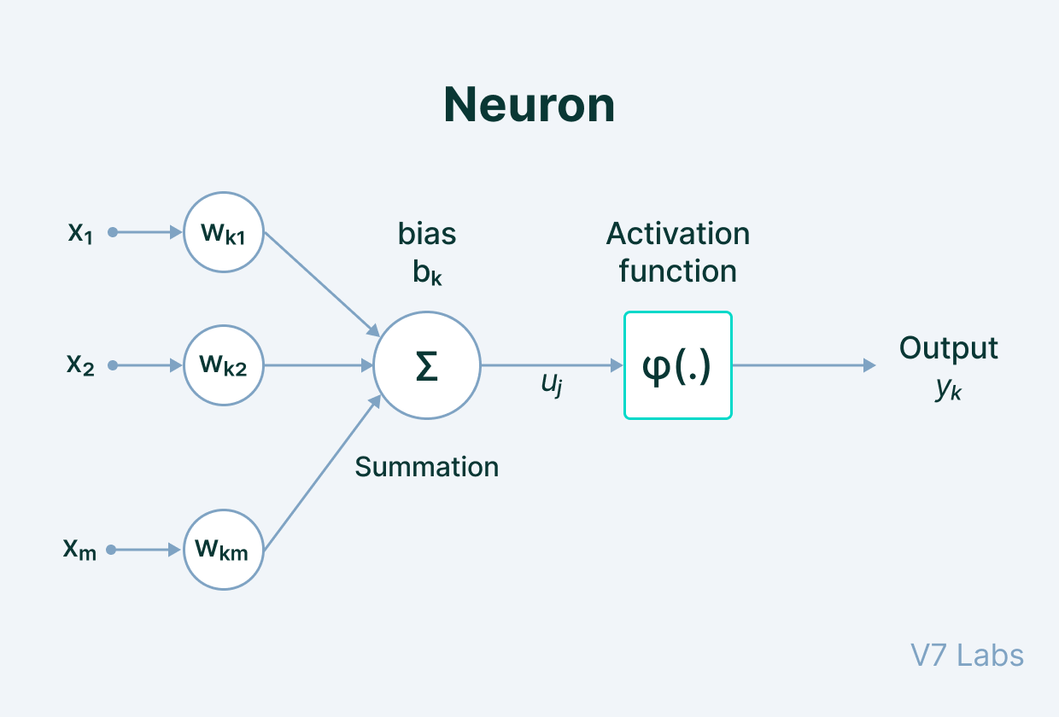
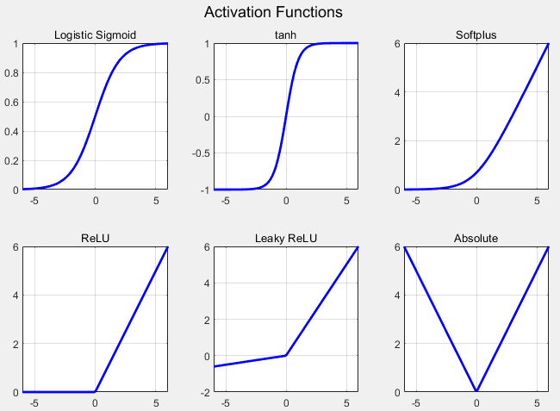
Parts of a Neural Network
Input layer: Receives raw features (e.g., pixel values, words, numbers)
Hidden units (neurons): Each unit computes a weighted sum of its inputs and applies a transformation
Weights & biases: Parameters the model learns to adjust influence of inputs
Activation function: Non-linear transformation (e.g., ReLU, sigmoid) that allows the network to learn complex patterns
Output layer: Produces final predictions (e.g., class label, probability, numeric value)
https://www.geeksforgeeks.org/machine-learning/neural-networks-a-beginners-guide/

Slide 24
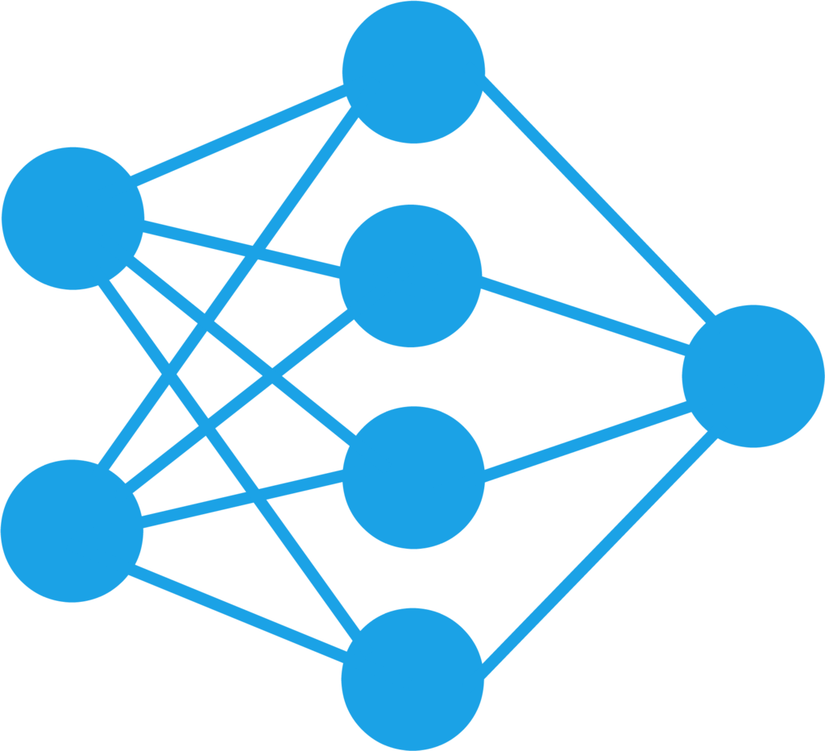
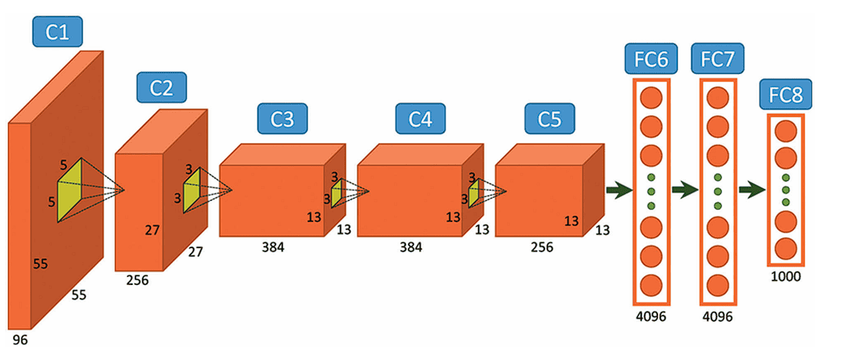
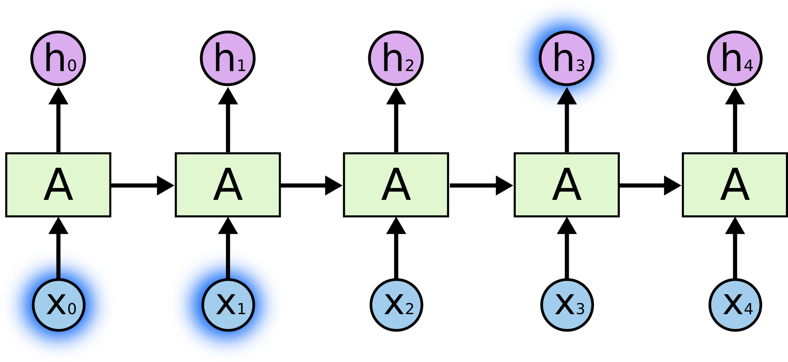
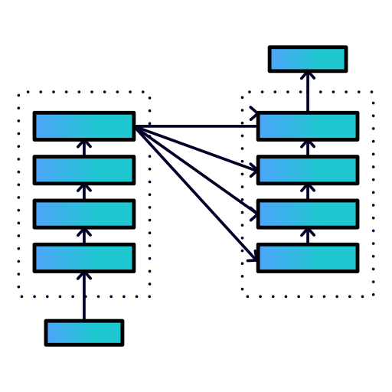
Types of Neural Networks
Feedforward Neural Network (FNN): Simplest form; data moves in one direction from input to hidden layers to output (no feedback connections)
Convolutional Neural Network (CNN): Specialized for image and spatial data; uses convolution filters to detect patterns such as edges, shapes, or textures
Recurrent Neural Network (RNN): Designed for sequential data (e.g., text, time series); connections allow information from previous steps to influence current output
Transformers: Modern architecture for handling sequences; relying on attention mechanism and power most large language models (LLMs)
https://www.geeksforgeeks.org/machine-learning/neural-networks-a-beginners-guide/

Slide 25

Creating Neural Networks in PyTorch vs. TensorFlow
PyTorch | TensorFlow
Define models by subclassing nn.Module Forward pass written explicitly in forward() Training loop handled manually (loss.backward(), optimizer.step()) | Define models with Sequential or Functional API using Keras Training loop often abstracted with model.compile() and model.fit() Can still use tf.GradientTape for custom loops
https://www.datacamp.com/tutorial/pytorch-vs-tensorflow-vs-keras
Notes:
When using TensorFlow, most people build models with Keras, the high-level API. Keras makes it simple to stack layers in just a few lines of code. Instead of writing your own training loop such as in PyTorch, you just compile the model, choose an optimizer and loss function, and call model.fit() to handle training. This abstraction makes it very beginner-friendly and great for rapid prototyping, but you can still use lower-level tools such as tf.GradientTape if you need more customization.”

Slide 26
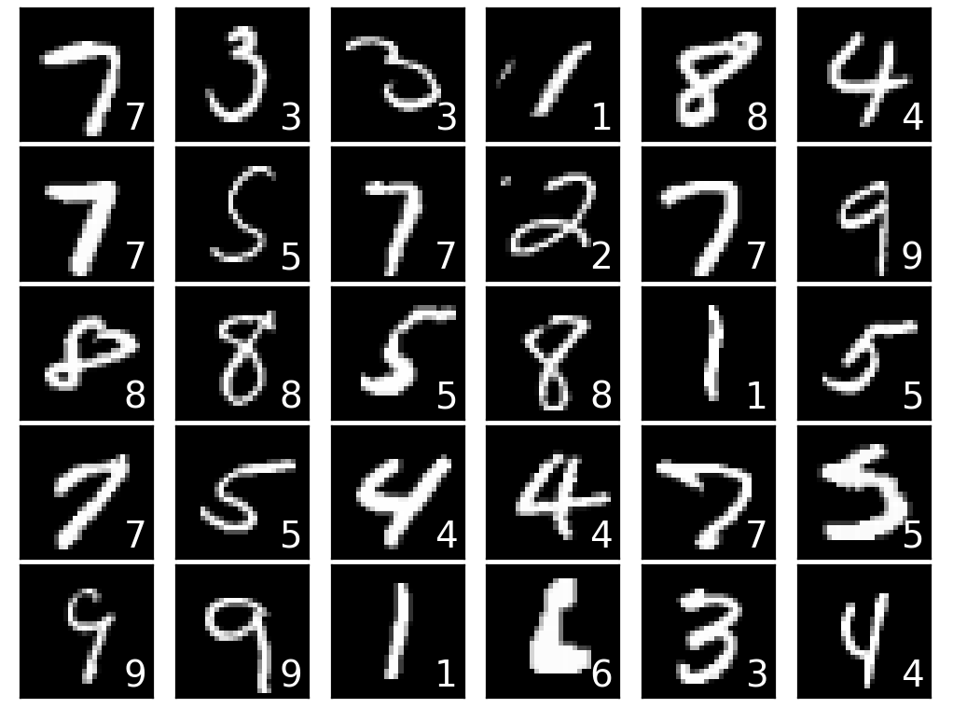
Intro to Demo Dataset: MNIST
MNIST Handwritten Digits
Classic benchmark dataset for neural networks (the "Hello World" dataset for deep learning)
70,000 grayscale images of handwritten digits (0-9)
Each image is 28 x 28 pixels
Task: Classify each image into the correct digit
https://archive.ics.uci.edu/dataset/683/mnist+database+of+handwritten+digits

Slide 27

Automatic Differentiation & Neural Network Demo
Scan here to access Jupyter Notebook

Slide 28
Comparison & Wrap-up

Slide 29
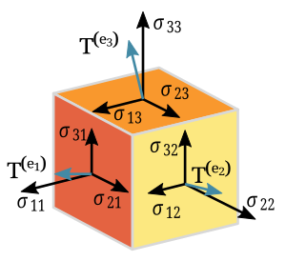


Key Takeaways
Tensors: n-dimensional foundational data structure of machine learning (generalization of matrices)
Automatic Differentiation: automates forward & backward passes of computational graphs
Training a Neural Network:
PyTorch: manual training loops for flexibility
Tensorflow: higher-level abstraction
Framework Usage:
PyTorch shines in research & prototyping
TensorFlow excels in production & deployment

Slide 30

Thank You
Questions?

